Slide 1
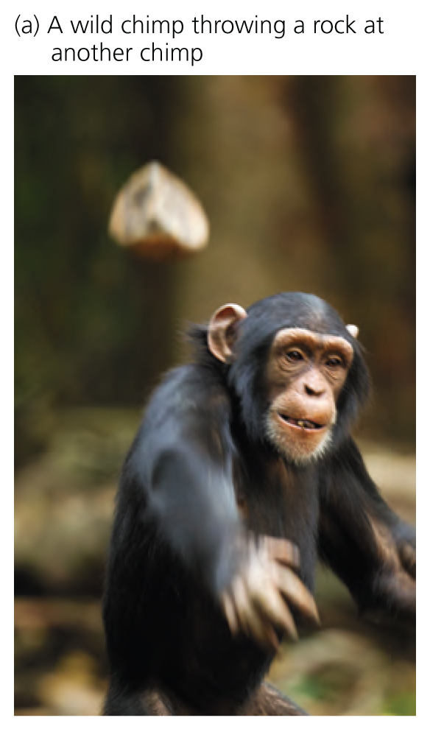
Lab 3: Are Humans Evolving by Natural Selection?
Notes:
Guess who is the other ape?

Slide 2
Housekeeping
GENERAL
Skills demos start today
DUE TODAY
Lab 3 pre-lab
Building Trees Take Home Assignment
DUE NEXT WEEK
Lab 4 pre-lab (Individual Research Plan)
Individual Scientific Reading Assignment

Slide 3

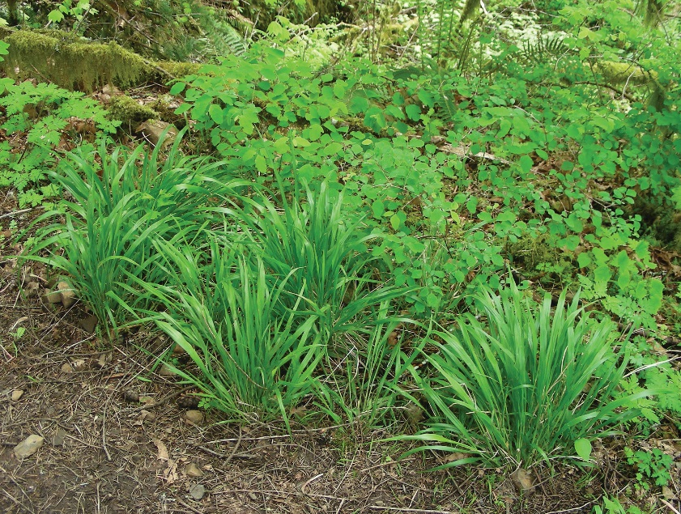
Term Project
This term we will be participating in a course project on the Oak Creek Watershed where we will be examining the impact of a noxious weed called false brome and studying the plant community ecology of the ecosystem in order to determine its impacts.
You will be developing your own scientific question and hypothesis as a group based on the available data and testing this hypothesis using the class data. Then you and your group will analyze the data collected by pervious students in the course and write up a final project report.
Notes:
This term we will be participating in a course project on the Oak Creek Watershed where we will be examining the impact of a noxious weed called false brome, and studying the plant community ecology of the ecosystem in order to determine its impacts. As part of participating in this course experiment, you will be developing your own scientific question and hypothesis as a group based on the available data and testing this hypothesis using the class data. You will be analyzing data collected by previous students enrolled in the course and writing up an individual final project report. The question, hypothesis and prediction planning and data analysis will be done in groups during lab time.

Slide 4
Term Project Timeline
Reviewing relevant primary literature | Individual Scientific Reading Assignment | Week 4
Developing a group research question | Individual research plan and group research plan | Week 4
Finding relevant primary literature | Individual Annotated Bibliography | Week 7
Data analysis | Group Data Analysis (in lab) | Week 7
Rough draft and peer review | Rough draft and peer review (in lab) | Week 8
Communicating findings in oral form | Group Presentations | Week 8
Communicating findings in written form | Individual Final Report | Week 9

Slide 5
Pre-Lab 4 (Individual Research Plan)
Learning Outcomes:
Design an experiment related to plant community ecology.
Differentiate between response and explanatory variables and biotic and abiotic factors.
Create a hypothesis, prediction and rationale.
General Instructions:
Read the introduction to the term project (lab manual)
Read the sampling protocol (lab manual) and watch the sampling video (Canvas)
Develop a research question that you could feasibly ask given the constraints of the sampling protocol about the Oak Creek Watershed
Note: All students will collect data using the entire sampling protocol. You will not be able to apply treatments or collect data not included in the sampling protocol. Plan accordingly.

Slide 6
Individual Scientific Reading Assignment Due Week 4 (10 pts)
Learning Outcomes:
Read and summarize the important components of a scientific article in a peer-reviewed journal.
Delineate the parts of a scientific article.
Explain how we use data in science.
Find and cite a scientific article according to disciplinary norms.
General Instructions:
Read “How to Read and Understand a Scientific Paper” article on Assignment instructions
Choose an article from the provided list on Canvas
Read the paper
Answer the reading questions (on Canvas)
You can just number your responses matching the number of the question.
Check your work using assignment rubric

Slide 7
Questions?

Slide 8
Today’s Learning Outcomes
Use DNA sequences to determine the relative similarity between individuals with different genomes.
Apply the concept of natural selection to human evolution.
Apply the process of science through hypothesis development, experimentation, and analysis of results.
Practice sampling protocol and entering data into a data sheet.
Describe the difference between recording data and creating a database.
Transfer data between a data collection program (using appropriate column names) and a data analysis program.
Use basic commands in R to produce data visualization.

Slide 9
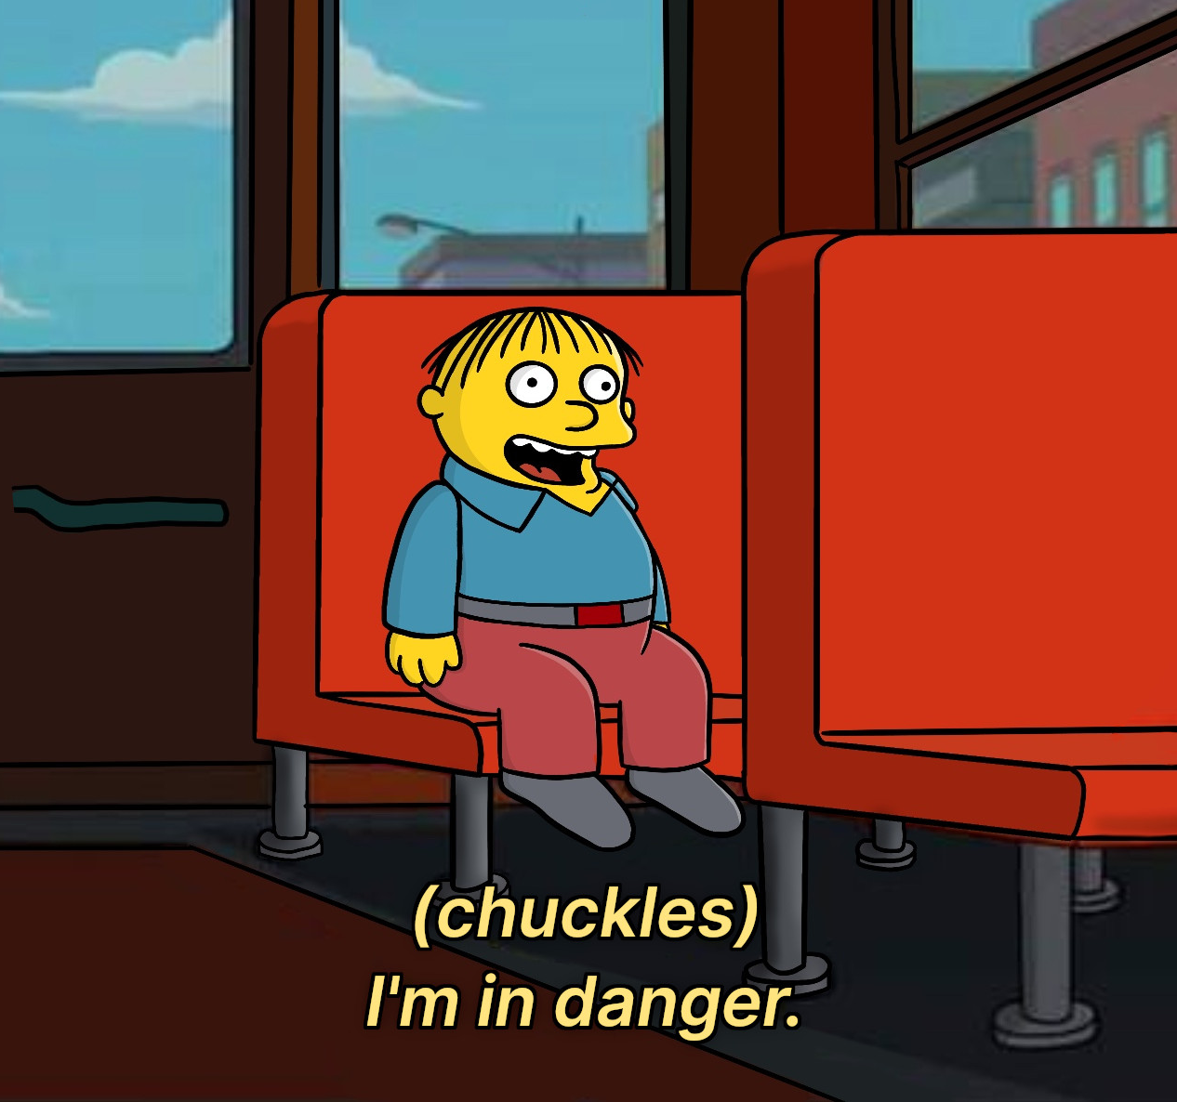

Pre-Lab Discussion: human evolution genomics
Discuss the following:
What are some limitations of researching human evolution?
What should researchers do to prevent the dangerous oversimplification of results by the media and policy-makers?
What are some of the ethical issues around human evolutionary genomics?

Slide 10
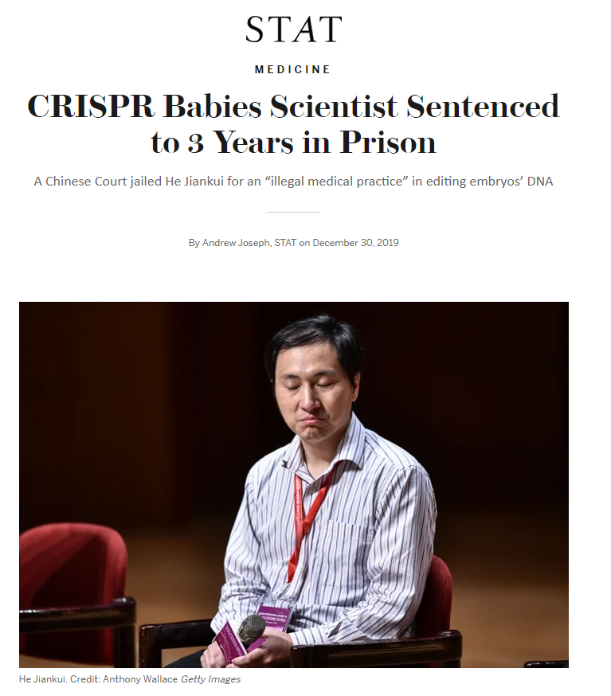

Slide 11
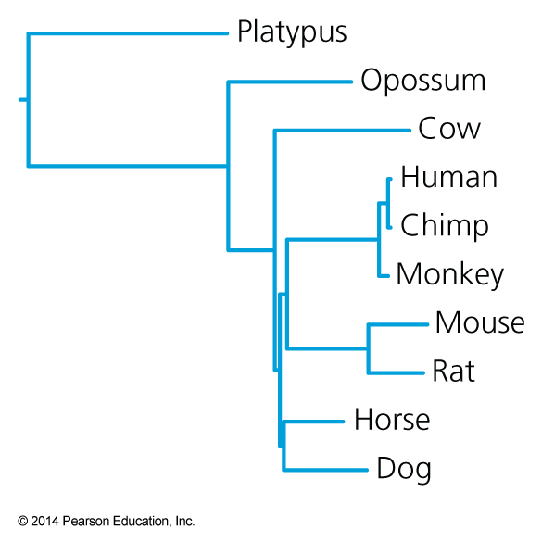
A whole-genome phylogeny of mammals
Notes:
A whole-genome phylogeny of mammals

Slide 12
A whole-genome phylogeny of mammals
Notes:
A whole-genome phylogeny of mammals

Slide 13
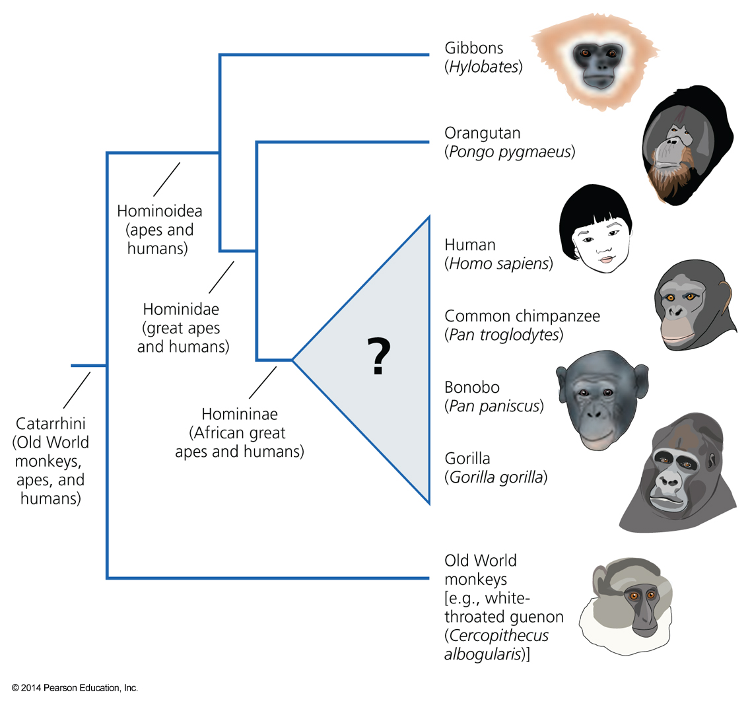
Notes:
Phylogeny of the apes
This evolutionary tree shows the relationships among the Old World monkeys, represented by a rhesus monkey, and the apes and humans. Among the apes, the gibbons branch off first, followed by the orangutan. The evolutionary relationships among the gorilla, the two chimpanzees, and humans (triangle with question mark) were long the subject of considerable dispute.

Slide 14
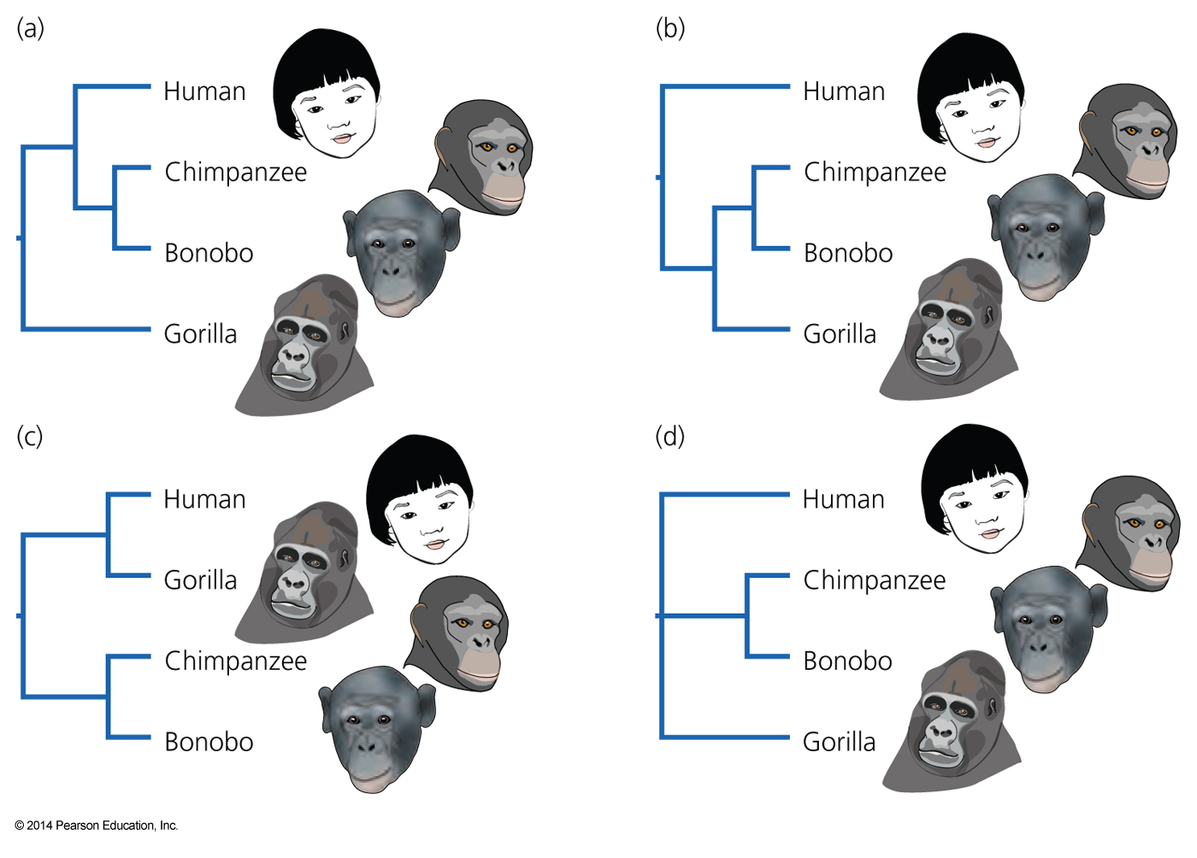
Notes:
Possible phylogenies of humans and the African great apes
Four possible resolutions of the evolutionary relationships among humans and the African great apes. All assume that the two species of chimpanzee are closest relatives. The true tree could have (a) humans and chimpanzees as closest relatives, (b) chimpanzees and gorillas as closest relatives, (c) humans and gorillas as closest relatives, or (d) a genuine simul taneous three-way split (polytomy). It is probably safe to say that more scientists have invested more effort in
attempting to determine which of these trees is correct than has been invested in any other species-level problem in the history of systematics.

Slide 15
Notes:
Possible phylogenies of humans and the African great apes
After decades of debate, researchers have come to a consensus that the evolutionary relationships among humans and the African great apes are best characterized by the tree in Figure 20.3a. Humans and the chimpanzees are more closely related to each other than either is to gorillas. This consensus was slow in forming, for at least two reasons: There were conflicts among molecular data sets, and there were conflicts between molecular evidence and morphological evidence.

Slide 16
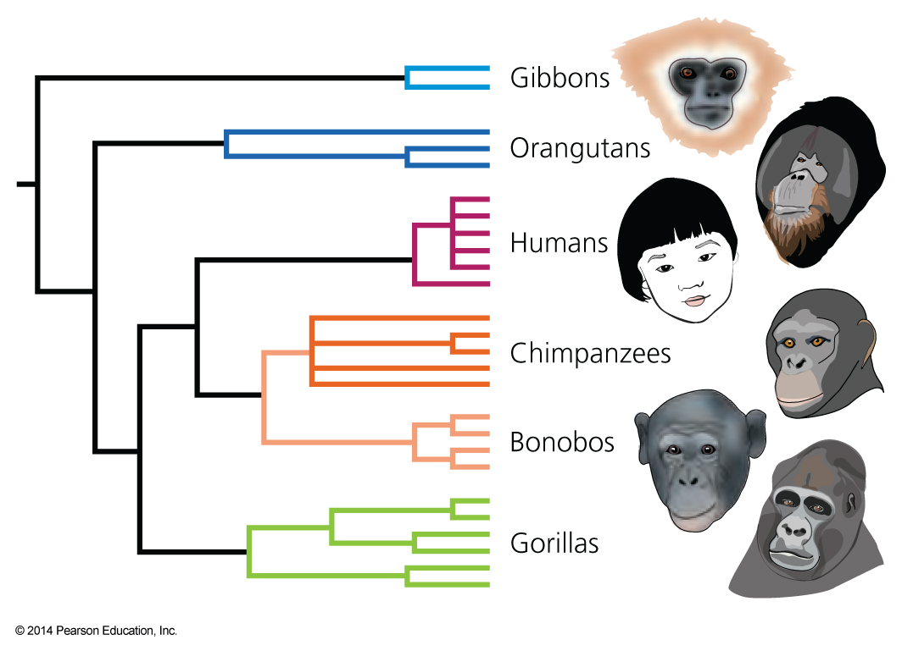
Phylogeny of mitochondrial cytochrome oxidase II alleles in humans and the African great apes
Notes:
Phylogeny of mitochondrial cytochrome oxidase II alleles in humans and the African great apes
Ruvoloand colleagues estimated this tree using the maximum parsimony method. From Ruvolo et al. (1994)

Slide 17
Phylogeny of mitochondrial cytochrome oxidase II alleles in humans and the African great apes
Notes:
Phylogeny of mitochondrial cytochrome oxidase II alleles in humans and the African great apes
Ruvoloand colleagues estimated this tree using the maximum parsimony method. From Ruvolo et al. (1994)

Slide 18
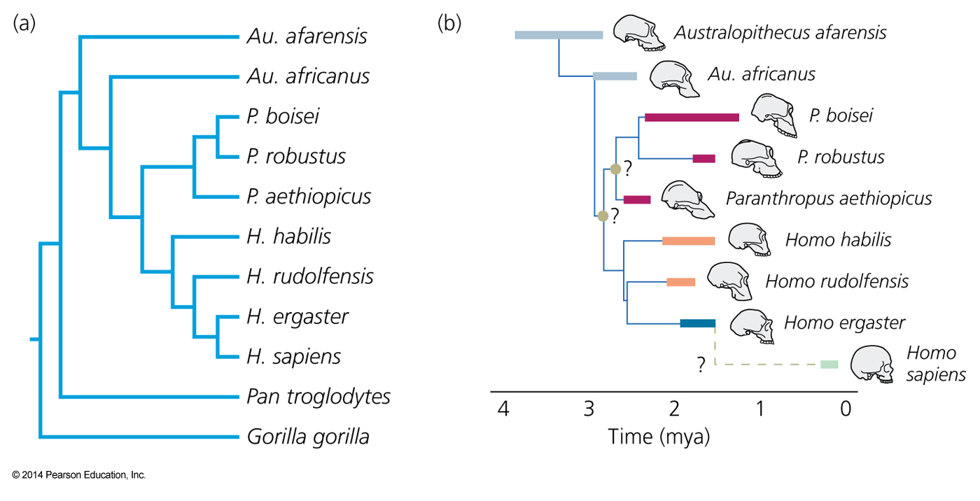
Cladogram and phylogeny of Homo sapiens and its recent ancestors and extinct relatives
Notes:
Cladogram and phylogeny of Homo sapiens and its recent ancestors and extinct relatives
(a) Cladogram of three extant hominins (gorilla, common chimp, and human) and several extinct hominins. (b) A hypothesis about the ancestor–descendant relationships implied by the cladogram in (a). Heavy bars, colored as in Figure 20.22,
show known time ranges; heavy dashes show suspected time ranges. After Strait et al. (1997).

Slide 19
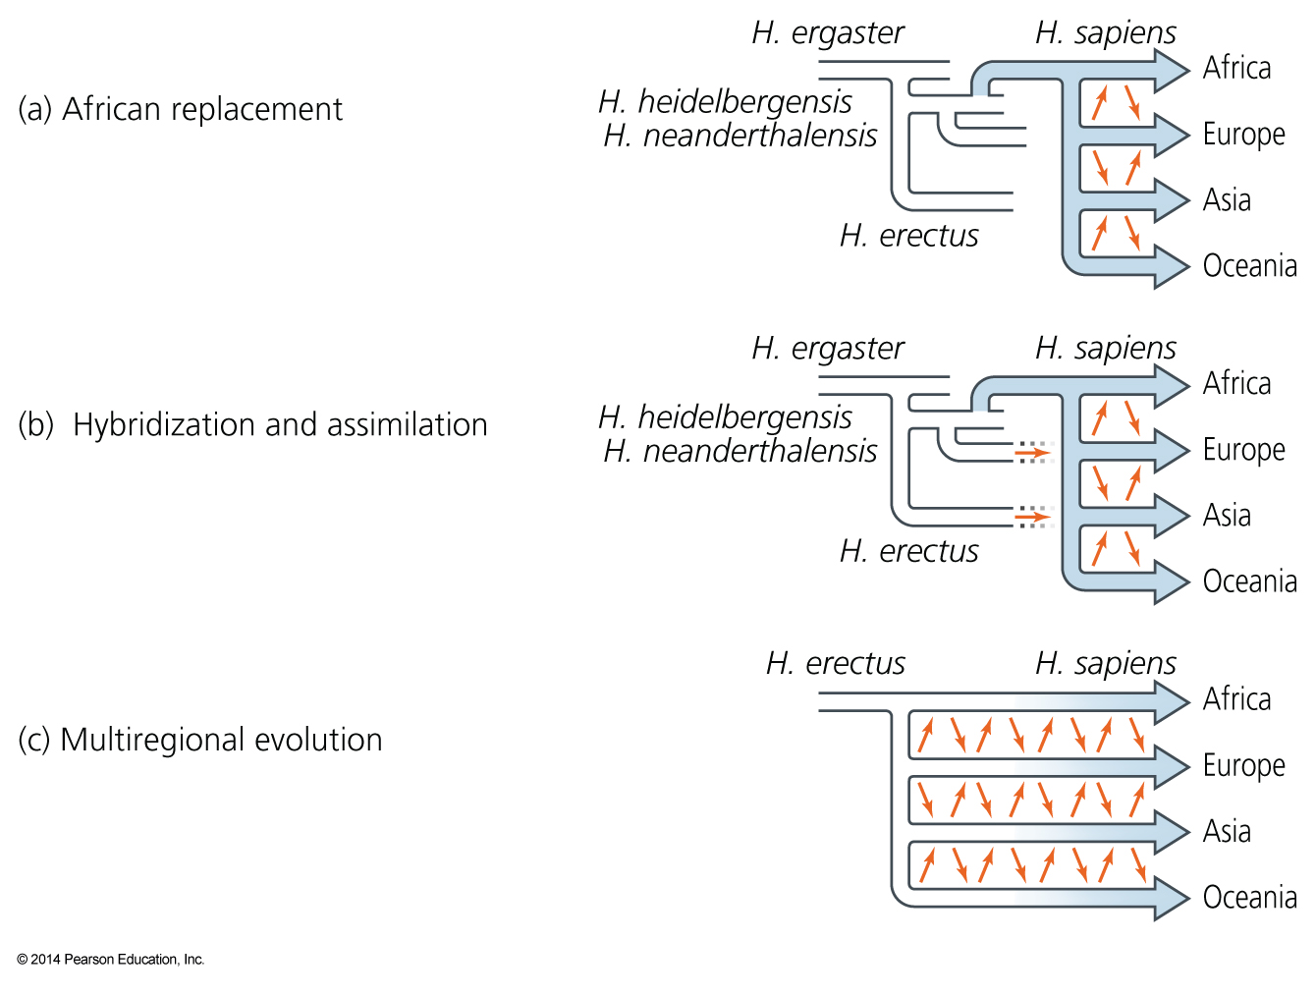
Notes:
Hypotheses on the transition from archaic to anatomically modern humans
White branches represent archaic humans; colored branches modern forms. Small orange arrows represent gene flow. Note that specimens identified as H. heidelbergensis have been found in Europe and Africa, and specimens identified as H. neanderthalensis have been found in Europe and the Middle East. After Aiello (1993); Ayala et al. (1994); Tattersall (1997).
Between the extremes is the hybridization and assimilation model (Figure 20.26b). It holds that modern humans evolved in Africa, then migrated to Europe, Asia, and beyond. Homo sapiens replaced archaic forms, but with hybridization between newcomers and established residents. As a result, some genes from archaic local populations were assimilated and persist in modern populations.

Slide 20
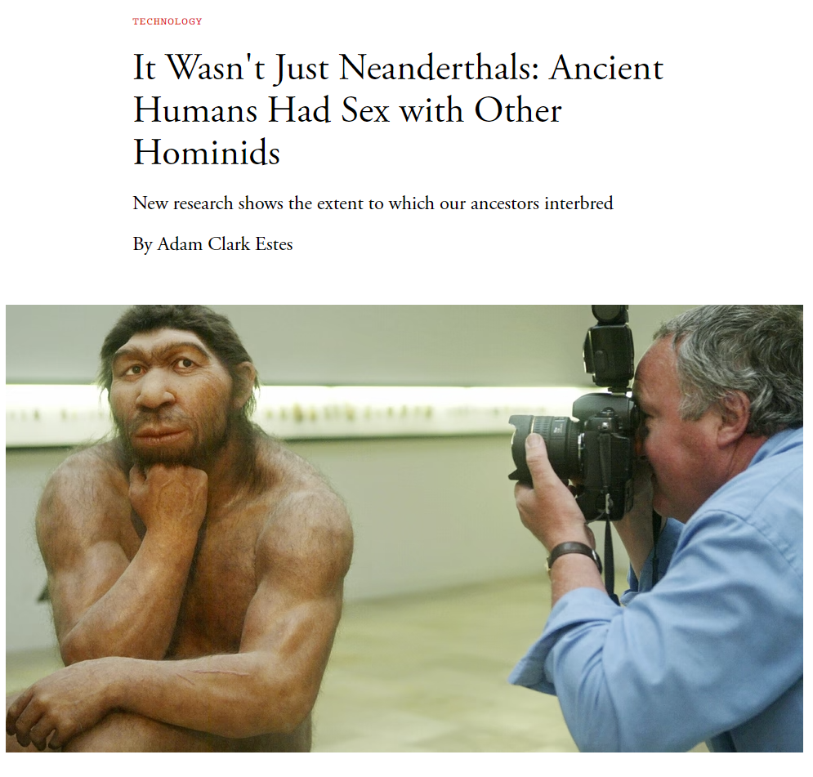

Slide 21
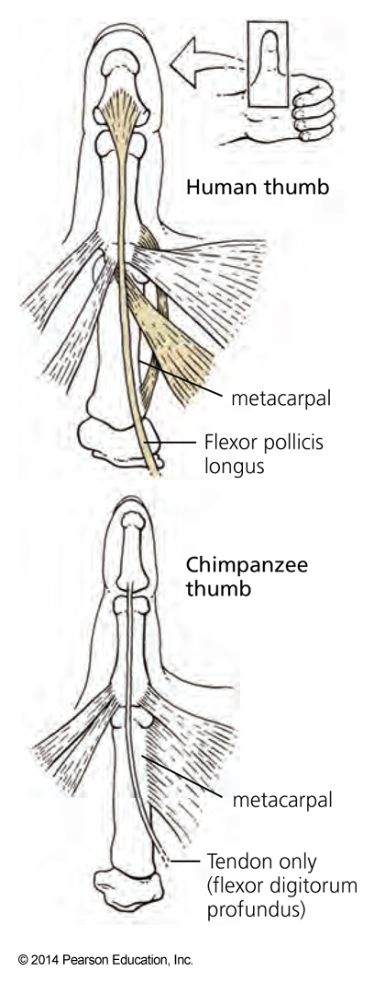
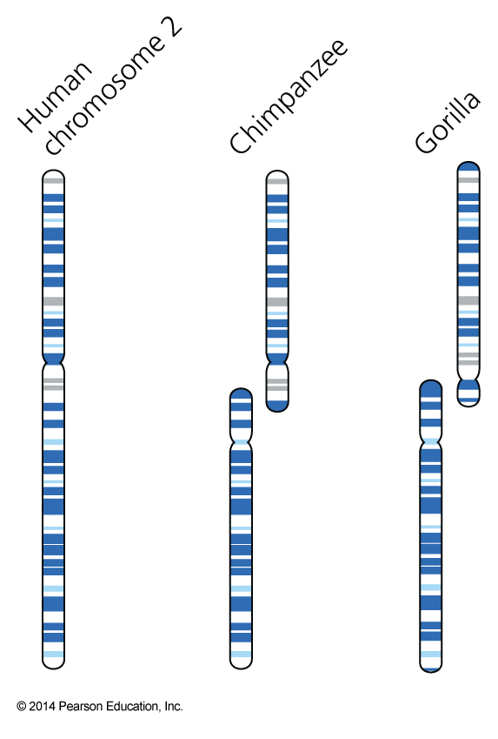
Notes:
Human chromosome 2 and its homologs in chimpanzees and gorillas
The banding patterns on stained chromosomes reveal that human chromosome 2 is derived from the fusion of two chromosomes that remain separate in the other great apes. Redrawn from Yunis and Prakash (1982).

Slide 22
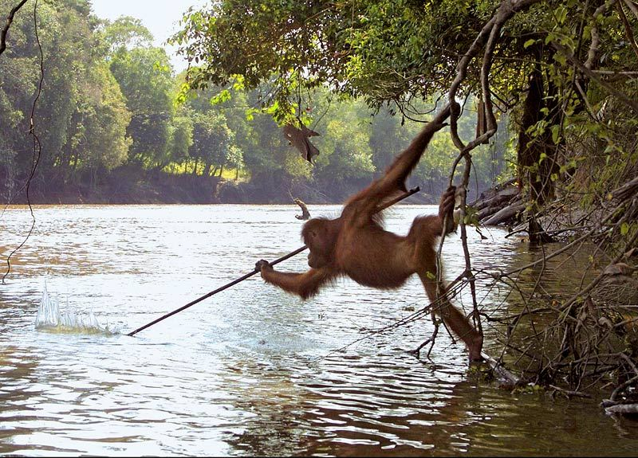
@GerdSchuster

Slide 23
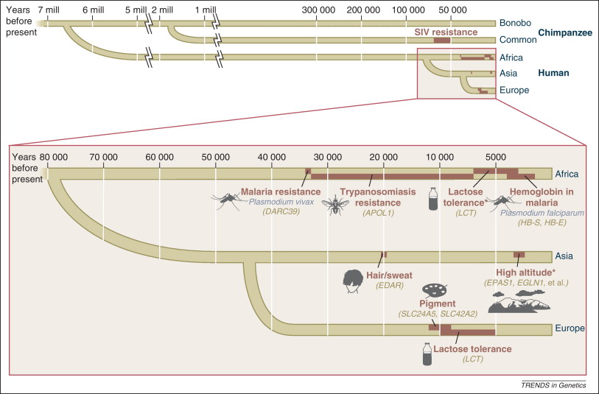
Evidence of recent evolution in humans
Vitti et al. 2011.
Notes:
Highlight evolutionary traits

Slide 24
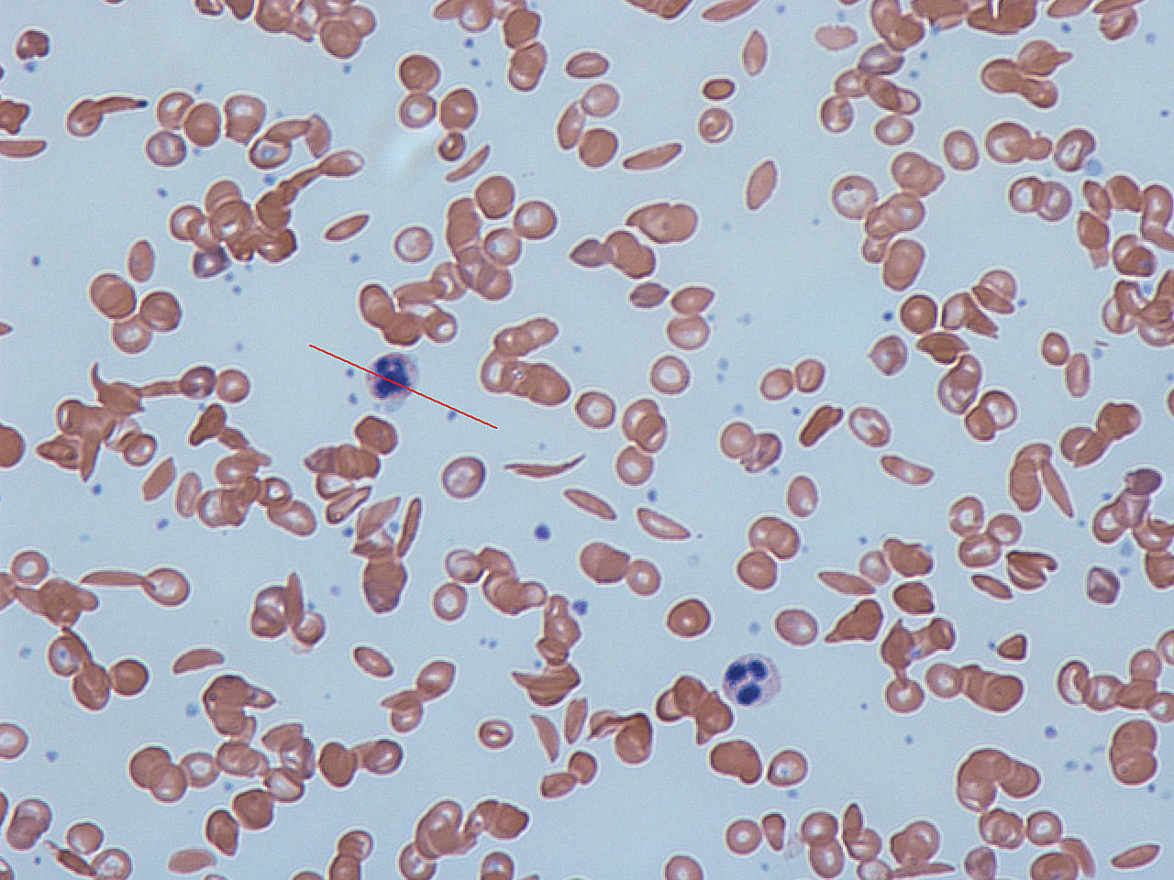
Evidence of recent evolution in humans
Sickle Cell trait against Malaria
Vitti et al. 2011.

Slide 25

Evidence of recent evolution in humans
Pale skin
Vitti et al. 2011.

Slide 26
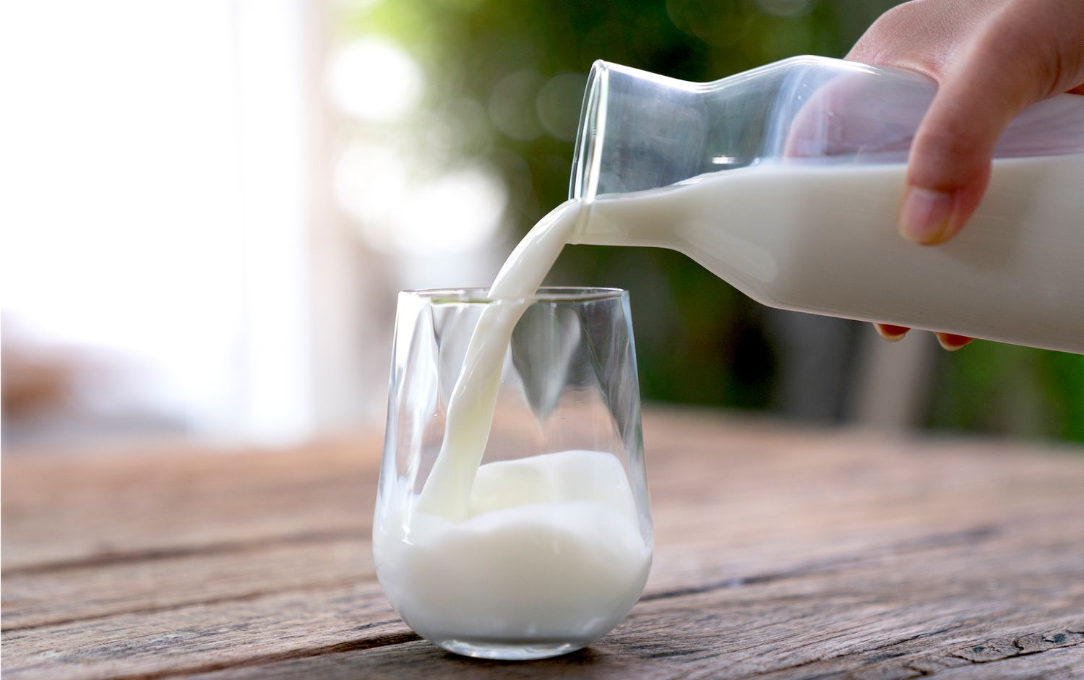
Evidence of recent evolution in humans
Lactose tolerance
Vitti et al. 2011.

Slide 27
Evidence of recent evolution in humans
Socio-political implications of the challenges
with interpreting trees
Vitti et al. 2011.
Notes:
However, misinterpretations can have implications. Eg the misconception that Black people are more closely related to apes than other races.

Slide 28
Another misconception
More recent evolution does not mean the organism is “better” evolved, or more superior, it just makes that organism better suited to a particular environment
Vitti et al. 2011.
Notes:
However, misinterpretations can have implications. Eg the misconception that Black people are more closely related to apes than other races.

Slide 29
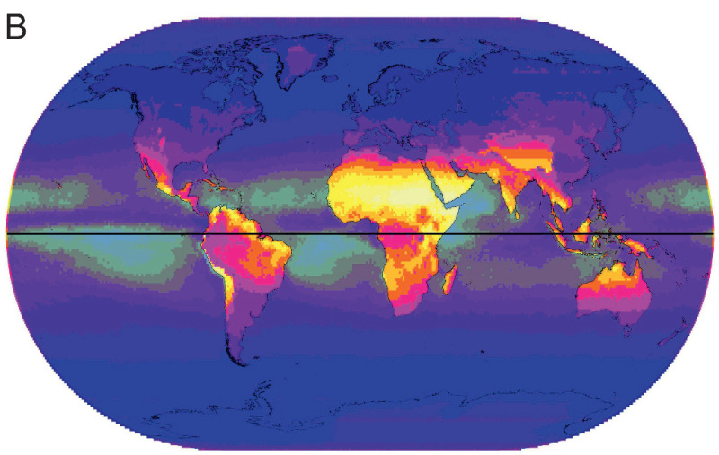
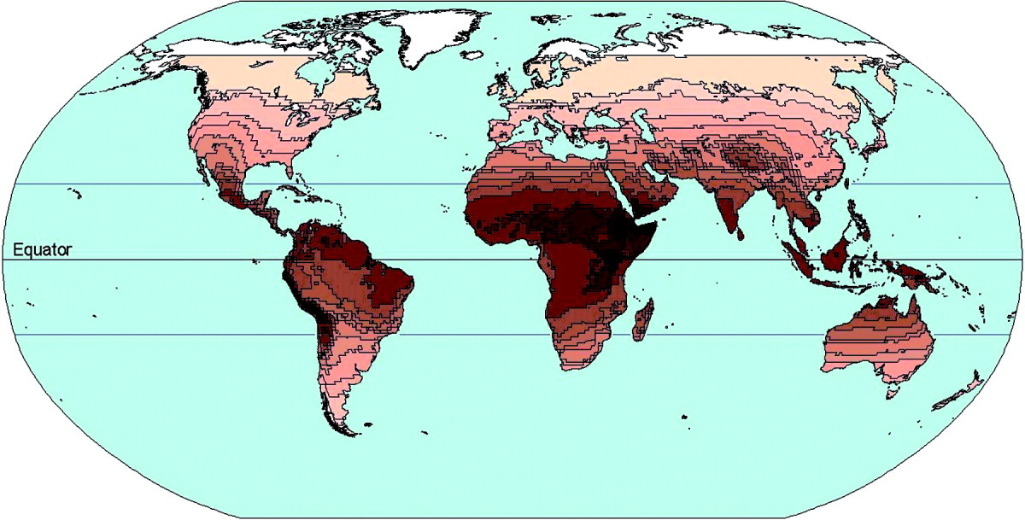
Another misconception
UV B
Skin coloration
Chaplin 2007
Jablonski and Chaplin 2010.
More recent evolution does not mean the organism is “better” evolved, or more superior, it just makes that organism better suited to a particular environment
Notes:
However, misinterpretations can have implications. Eg the misconception that Black people are more closely related to apes than other races.
https://www-ncbi-nlm-nih-gov.oregonstate.idm.oclc.org/books/NBK210015/

Slide 30
Another misconception
UV B
Skin coloration
Chaplin 2007
Jablonski and Chaplin 2010.
Lighter skin evolved as a response to the reduced availability of UV light.
Notes:
However, misinterpretations can have implications. Eg the misconception that Black people are more closely related to apes than other races.
https://www-ncbi-nlm-nih-gov.oregonstate.idm.oclc.org/books/NBK210015/

Slide 31
Questions?

Slide 32
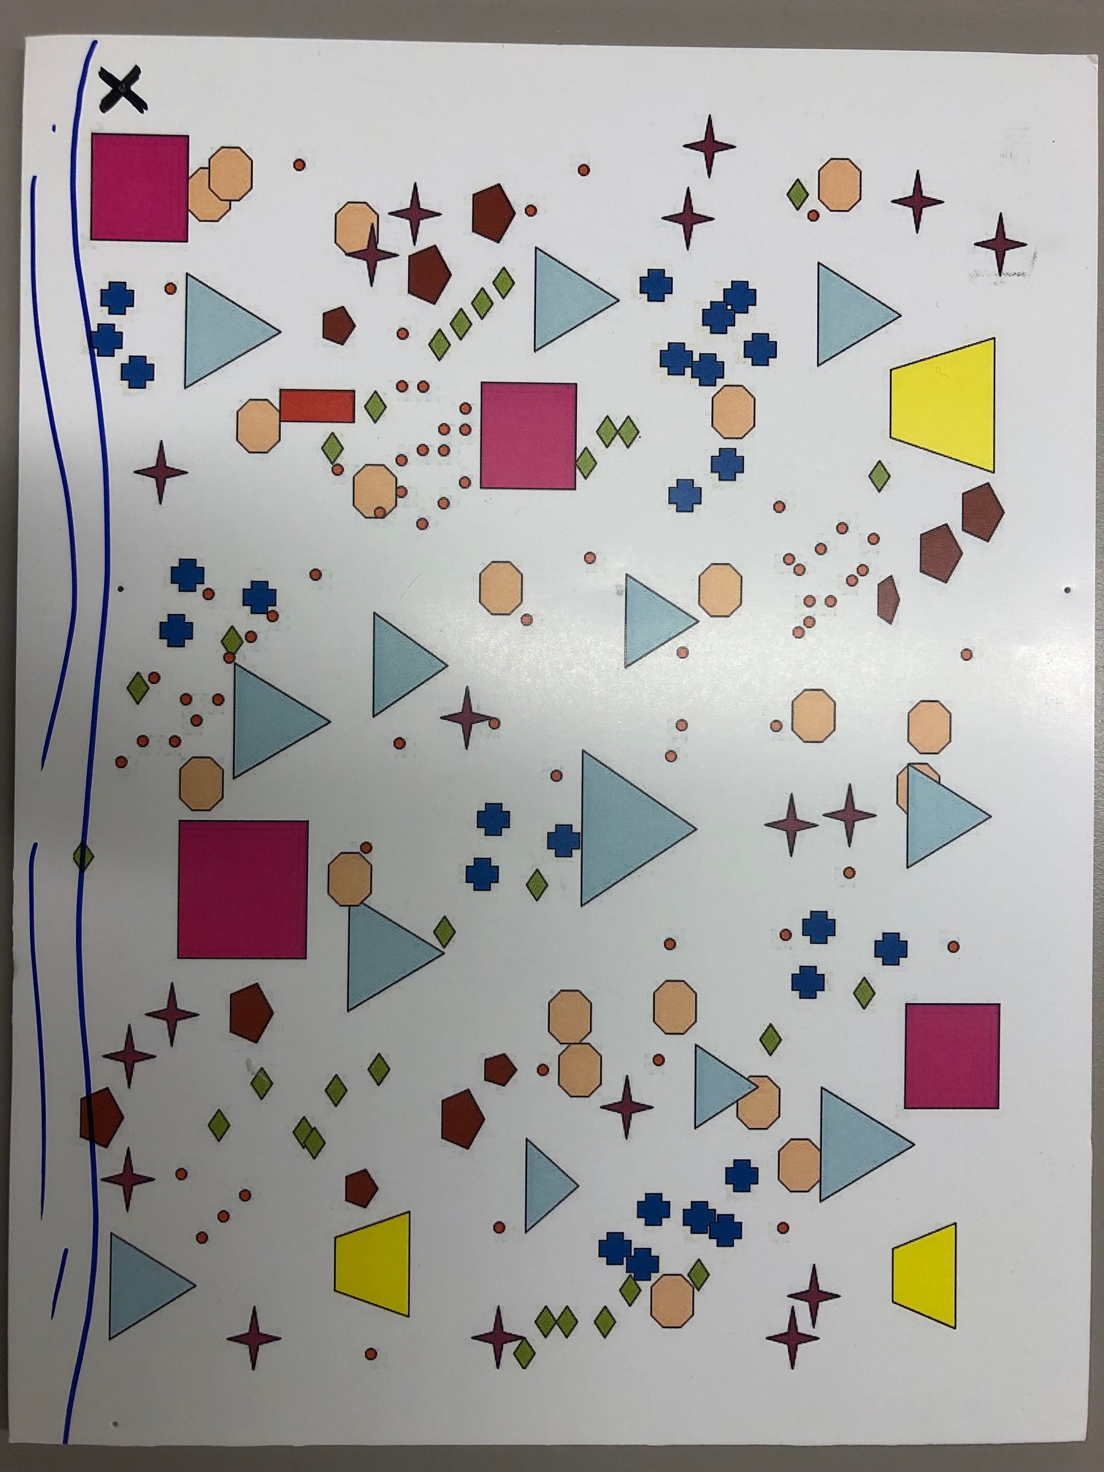
Part 1: data collection practice
Two different foam boards represent two different terrestrial areas.

Slide 33

Part 1: data collection practice
Using pins and a string – create a base transect along the river starting at the X.

Slide 34
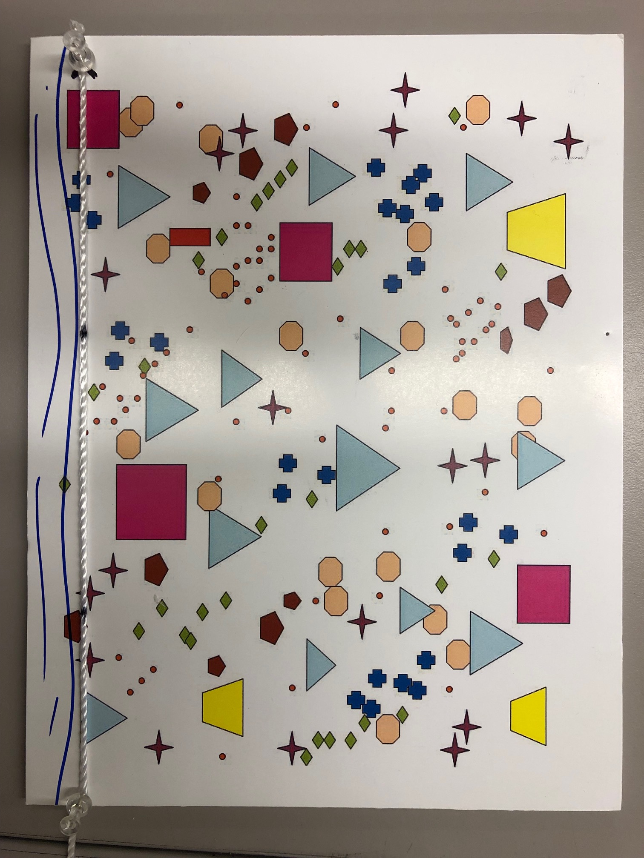
Part 1: data collection practice
Using pins and a string – create a measurement transect orthogonal to the base transect (at the first black mark).

Slide 35
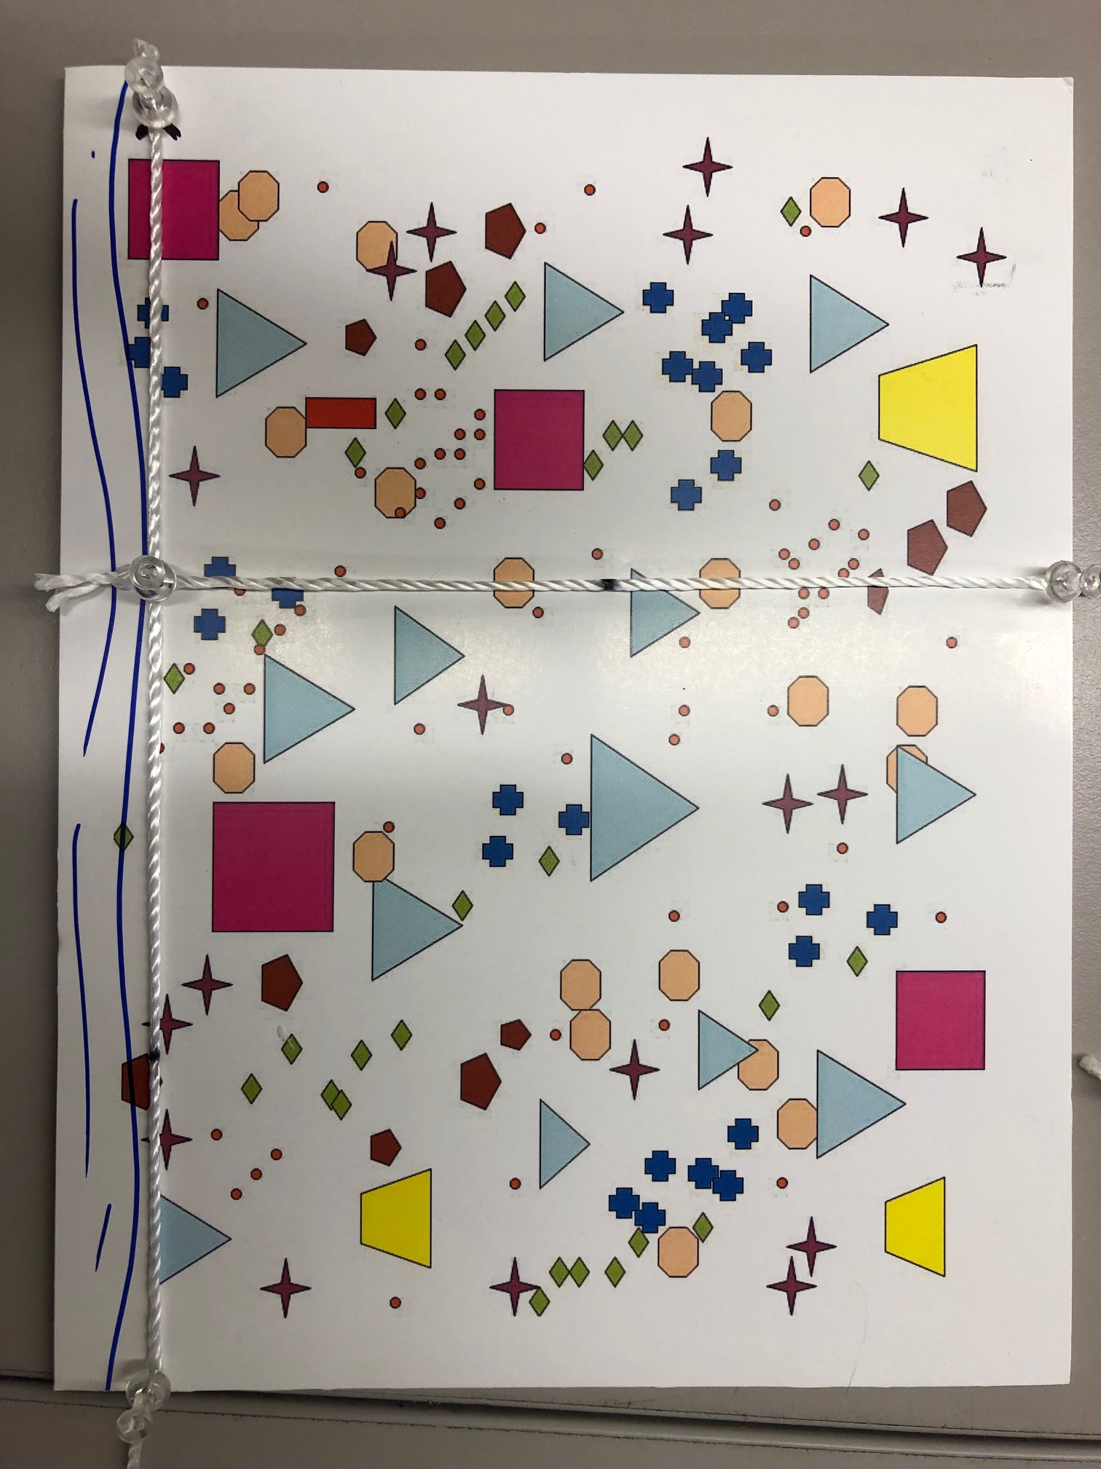
Part 1: data collection practice
Place transparent squares along alternating sides of the measurement transect – these represent our quadrats.
Note: the quadrat should be places along the transect such that the bottom edge is at the desired distance from the creek

Slide 36
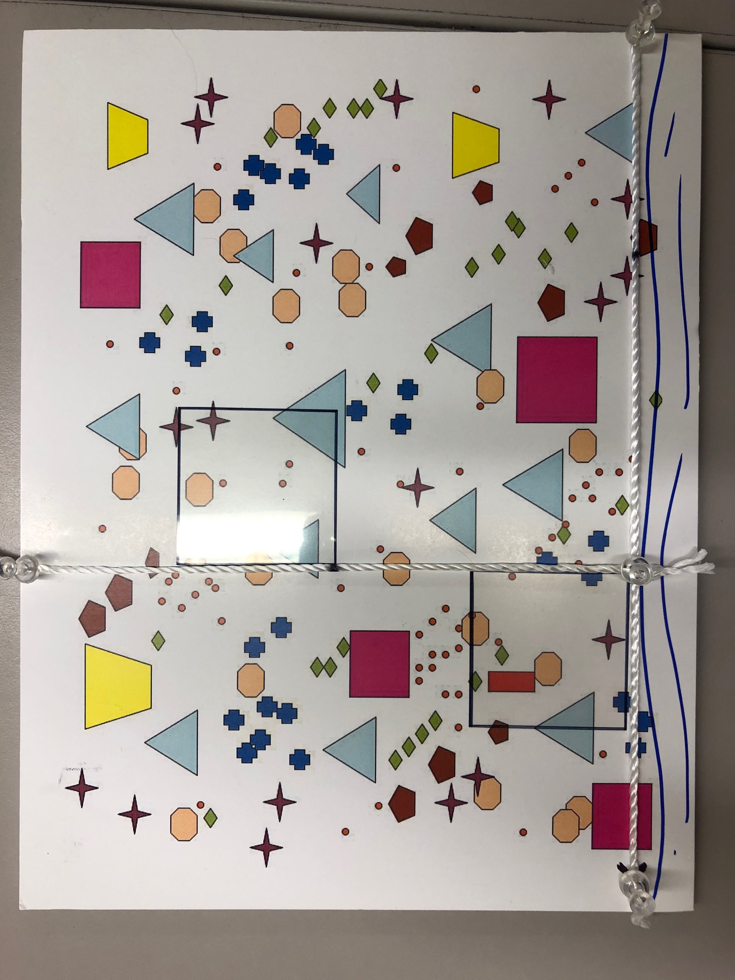
Part 1: data collection practice
Take measurements within the squares.
# of different trees, shrubs, and herbs
% coverage of trees, shrubs, herbs, and ground cover (white space)
Tree density: distance and size

Slide 37
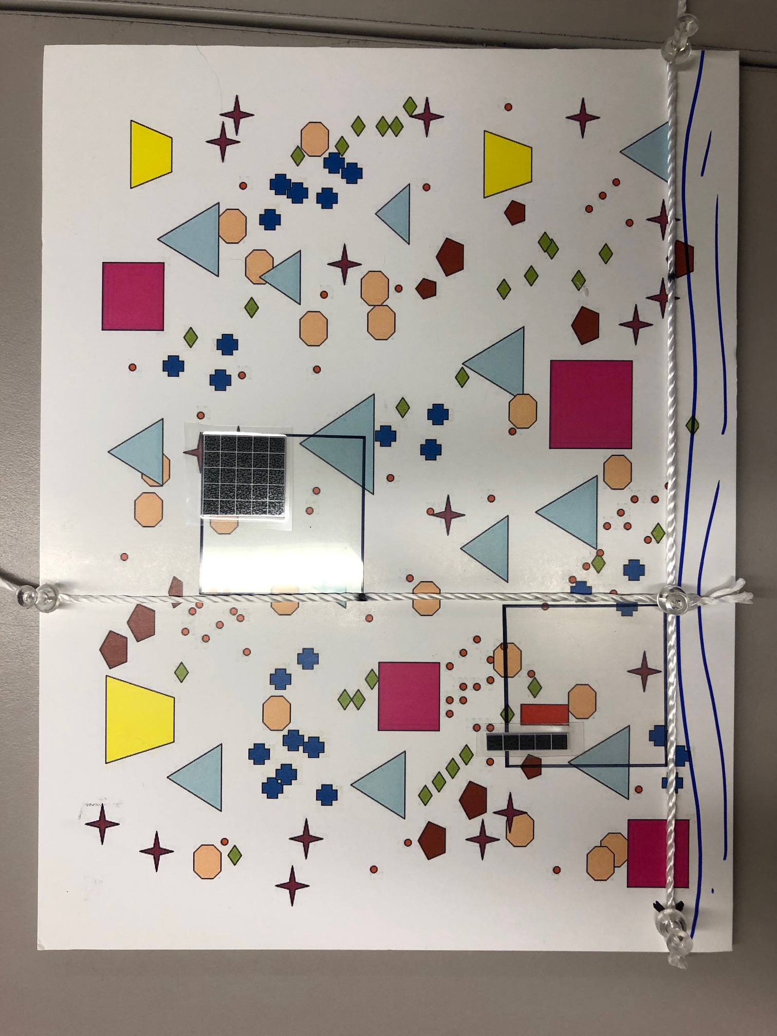
Part 1: data collection practice
For determining percent coverage
25%.
5%
1%

Slide 38
Part 1: data collection practice
Shrubs Diversity: % coverage:
Herbaceous Diversity: % coverage:
Ground % coverage:

Slide 39
Part 1: data collection practice
Shrubs Diversity: % coverage:
Herbaceous Diversity: % coverage:
Ground % coverage:

Slide 40
Part 1: data collection practice
Shrubs Diversity (number different): % coverage:
Herbaceous Diversity: % coverage:
Ground % coverage:

Slide 41
Part 1: data collection practice
Shrubs Diversity: % coverage:
Herbaceous Diversity: % coverage:
Ground % coverage: (100 – shrub – herb – tree)

Slide 42
Part 1: data collection practice
Trees (4)
NW, NE, SW, SE
NW
NE
SW
SE

Slide 43

Part 1: data collection practice
Trees (4) NW, NE, SW, SE
Distance: use ruler to get distance. Distance is measured from top corner touching the transact line.
NW
NE
SW
SE

Slide 44
Part 1: data collection practice
Trees (4) NW, NE, SW, SE
Distance: use ruler to get distance.
DBH (Diameter by Breast Height):
Use ruler to get length of shape
NW
NE
SW
SE

Slide 45
Part 1: data collection practice
Trees (4) NW, NE, SW, SE
Distance: use ruler to get distance. Distance is measured from top corner touching the transact line.
DBH:
Use ruler to get length of shape
Species: Shape – eg blue triangle
NW
NE
SW
SE
Repeat for other three directions

Slide 46
Part 1: data collection practice
Repeat process in 4 quadrats per area

Slide 47
Google Sheet Database Template
Go to Canvas and look for the Google Sheet’s link, under Lab Materials;
Download that as a .xlsx spreadsheet;
Add the practice data you just collected. We will use this same template for the real data we will collect in Lab 6.

Slide 48
Part 2: Data Analysis
Use data from part 1
To ensure R can read your column names use: camelCase
or snake_case
Import and graph data using R

Slide 49
Part 3: Human Evolution and Disease
Imagine you’re a scientists working at the Human Genome Project studying mitochondrial DNA (mtDNA) on a global scale!
One might hypothesize that people from similar geographic regions would have a higher degree of genetic similarity. Is that true?
Download matrix of sequences (.xls) from Canvas then use the matrix to calculate the number of base pair differences between sequences and answer the questions in your lab manual.
Use the .fasta file to create a phylogenetic tree of these populations in MEGA

Slide 50
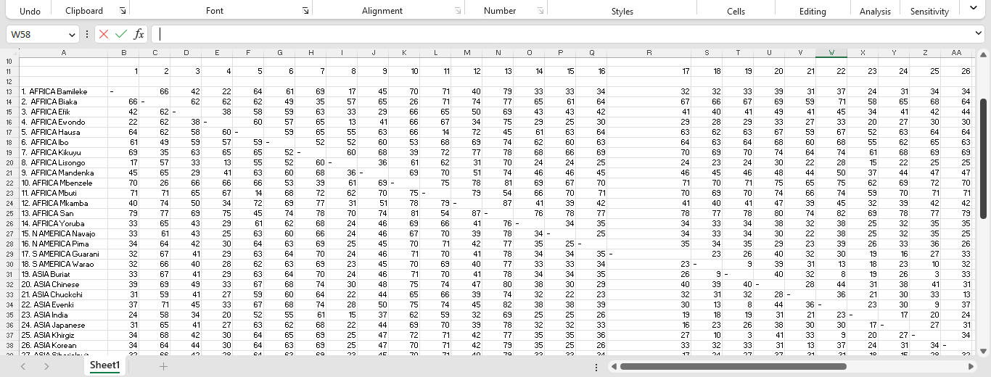
Part 3.1: Human Evolution
To compare to regions: use the rows of one and the columns of another

Slide 51
Part 3.1: Human Evolution
To compare within Africa: use the rows of Africa and the columns of Africa

Slide 52
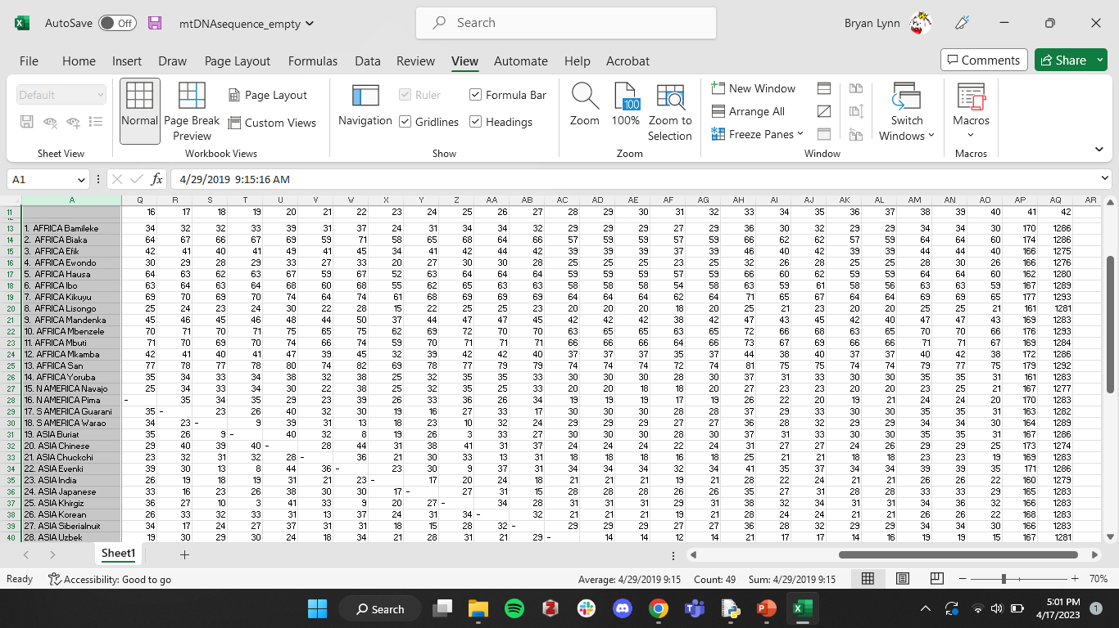
Part 3.1: Human Evolution
To compare between Africa and America: use the rows of Africa and the columns of America

Slide 53

The Wide World of Science!
Masatoshi Nei
1931- 2023 :(
Author of MegaX software
Aided/co-authored by graduate student Sudhir Kumar and post-doc Koichiro Tamura
Co-founded the journal Molecular Biology and Evolution in 1983 and the Society for Molecular Biology and Evolution in 1993
Invented Nei’s distance, measure of genetic divergence
Advanced the theory of mutation-driven evolution
Notes:
Notes from slide:
Author of MegaX software
Aided/co-authored by graduate student Sudhir Kumar and post-doc Koichiro Tamura
Co-founded the journal Molecular Biology and Evolution in 1983 and the Society for Molecular Biology and Evolution in 1993
Invented Nei’s distance
Advanced the theory of mutation-driven evolution
Additional notes:
Japanese American born in Miyazaki, 1931
Nei was the first to show mathematically that, in the presence of gene interaction, natural selection always tends to enhance the linkage intensity between genetic loci or maintain the same linkage relationship.
He also showed that deleterious mutations can accumulate rather quickly on the Y chromosome or duplicate genes in finite populations
He proposed the neutral theory of molecular evolution (most evolutionary changes occur at the molecular level, and most of the variation within and between species, are due to random genetic drift of mutant alleles that are selectively neutral. The theory applies only for evolution at the molecular level)
Proposed his own measure of genetic distance, Nei’s distance, and using this metric showed that the genetic variation between Europeans, Asians, and Africans is only about 11 percent of the total genetic variation of the human population. This proportion is still roughly held to be true.
If students want to learn more, he has written a textbook, ‘Mutation Driven Evolution’. His work helped to strengthen these arguments and his algorithms further advanced our understanding of the Neutral Theory of Molecular Evolution
Sources
Nei, Masatoshi (1967). "Modification of linkage intensity by natural selection". Genetics. 57 (3): 625–641.
https://en.wikipedia.org/wiki/Masatoshi_Nei

Slide 54
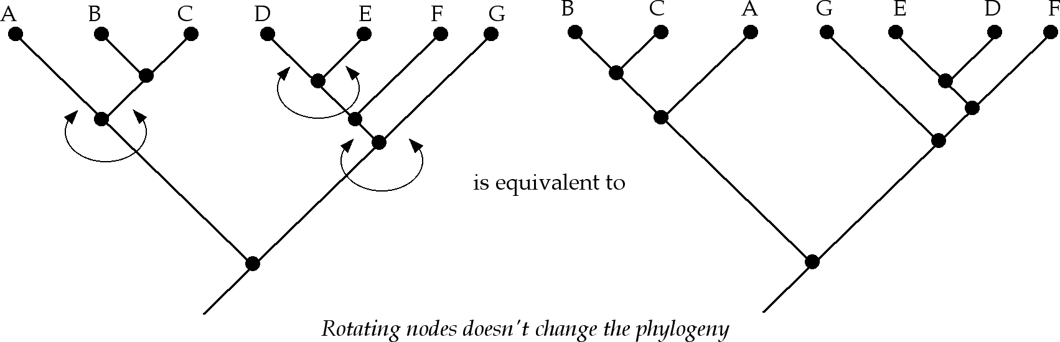
Similar trees can have many shapes
Notes:
This is where I would emphasize to students the importance of playing around with the tree in Mega. Unfortunately, the Mega tree erroneously places African populations next to Chimpanzees after the first run. It’s important to remind students that just because a clade is next to each other on the tree does not mean that they are closely related.
click on the icon that reads 'swap the selected subtree'
In this example, because chimpanzees are outgroup, you might imagine
chimpanzees as G,
Asian populations as E,
European populations as D,
and African populations as F. Notice how if we rotate the nodes, we don’t actually change the tree?

Slide 55
Today’s roadmap and tips:
Part 1: practicing data collection
It is easier to put the pin through the string than to wrap the string around it
½ m = 5 cm in your model
Part 2: Data Visualization
Open Rstudio early to avoid overloading the server
Don’t add the ‘>’ to your commands, this is there just to indicate that that is code! This is a standard.
Part 3: human evolution and disease susceptibility
I suggest copying the data into excel and using the min() and max() function on the groups to find the different values.
d: hint: think about the size of the continents and amount of time humans have lived there
2c: Make sure to select “Maximum PARSIMONY”
Clean Up
Log out of computers
Put all pieces of models back in the bag
Organize trays

